Slide 1
INT222
More on CSS, Page Layouts & Navigation (Part 2)

Slide 2
Agenda
CSS Styling
lists, tables and hyperlinks
CSS Centering & CSS Positioning
Page Layouts and Navigation

Slide 3
CSS Lists
The list-style-type CSS property specifies appearance of a list item element.
Examples:
{ list-style-type:circle; } { list-style-type:square; } { list-style-type:upper-roman; } { list-style-type:lower-alpha; }
Default value: disc
(See css_list.html example)

Slide 4
list-style-type Property Values
for a complete list, see: https://developer.mozilla.org/en/docs/Web/CSS/list-style-type
Value | Description | e.g.
none | No item marker is shown
disc | A filled circle (default value)
circle | A hollow circle
square | A filled square
decimal | Decimal numbers | 1, 2,
decimal-leading-zero | Decimal numbers (leading 0) | 01, 02, 03, … 98
lower-roman | Lowercase roman numerals | i, ii, iii, iv, v…
upper-roman | Uppercase roman numerals | II, III, IV, V…
lower-greek | Lowercase classical Greek | α, β, γ…
lower-alpha, lower-latin | Lowercase ASCII letters | a, b, c, … z
upper-alpha, upper-latin | Uppercase ASCII letters | A, B, C, … Z

Slide 5
Table Formatting with CSS
Tables are the most complex elements in HTML. A table may contain a:
caption, row, cell, row groups, and column groups, header section, body section, footer section…
Some CSS properties for table formatting include:
margin, padding, width, height, text-align, vertical-align, background-color, background-image, border

Slide 6
Table Formatting
Formatting the whole Table:
Formatting Table Cells:
(See css_table.html example)
table { margin: auto; width: 80%; }
table { border: 1px solid black;}
table { background-color: yellow; }
td { border: 4px inset #4400FF; }
td { padding:10px 20px;}
td { background-color: green; }
td { height: 100px; width: 400px; }
td { text-align: left; vertical-align: bottom; }

Slide 7
Border Collapse
Property: border-collapse sets whether the table borders are collapsed into a single border or separated.
Example:
table{
border-collapse: collapse;
}
table, th, td{
border: 1px solid black;
}

Slide 8
Table Sections/Groups
<thead> - group the first one or more rows of a table for formatting
<tbody> - group the middle rows of a table for formatting
<tfoot> - group the last one or more rows of a table for formatting
(See css_table_section.html example)

Slide 9
Styling Links
CSS pseudo-class: is a keyword added to selectors that specifies a special state of the element to be selected.
Syntax: Selector:pseudo-class { property: values; }
Anchor Pseudo-classes: links are styled differently depending on what state they are in:
a:link - a normal, unvisited link
a:visited - a link the user has visited
a:hover - a link when the cursor hovers over it
a:active - a link the moment it is clicked
Note: When setting the style for several link states, you must declare the pseudoclasses in the above order in your CSS file, ie: :link :visited :hover: active
(See css_link.html & css_link-as-button.html examples)

Slide 10
CSS – display Property
The display CSS property specifies the type of rendering box used for an element.
default value: inline
the value none lets you turn off the display of an element.
Example:
(See css_display.html example)
p.inline { display: none; }

Slide 11
The display Property Values
Value | Description
inline | Default value. Displays an element as an inline element (like <span>)
block | Displays an element as a block element (like <p>)
inline-block | Displays an element as an inline-level block container. The inside of this block is formatted as block-level box, and the element itself is formatted as an inline-level box
inline-table | The element is displayed as an inline-level table
list-item | Let the element behave like a <li> element
table | Let the element behave like a <table> element
table-caption | Let the element behave like a <caption> element
table-column-group | Let the element behave like a <colgroup> element
table-header-group | Let the element behave like a <thead> element
table-footer-group | Let the element behave like a <tfoot> element
table-row-group | Let the element behave like a <tbody> element
table-cell | Let the element behave like a <td> element
table-column | Let the element behave like a <col> element
table-row | Let the element behave like a <tr> element
none | The element will not be displayed at all (has no effect on layout)

Slide 12
Centering Lines Of Text
Centering lines of text in a paragraph or in a heading.
(See center_text.html example)
p { text-align: center }
h2 { text-align: center }

Slide 13
Centering a Block
Rephrase: left and right margin to be equal.
set the margins to 'auto'.
used with a block of fixed width.
(See center_block.html example)
div.center {
border: 2px solid red;
margin-left: auto;
margin-right: auto;
width: 400px;
}
<div class ="center"> … </div>

Slide 14
Positioning
CSS position property
can be used to position elements precisely in HTML pages.
a browser renders html statements in the order that they are in the html file - this is called normal flow

Slide 15
Positioning
Values for property: position
absolute - position precisely within the containing element
relative - position precisely relative to normal flow
fixed - position precisely within the browser window, and does not move when the page is scrolled
static - position using normal flow (default)
Values for Properties: "left", "right", "top", and "bottom" can be given offsets in px or %
NOTE: If you want to position a <div> using "absolute" positioning, relative to the parent element, the parent element cannot have be positioned using "static"
NOTE: Pay close attention to the "z-index" property when using position absolute
(See position.html & position_relative.html examples)

Slide 16
Positioning
What if the text takes more than the allotted space?
use the property "overflow" to specify an action:
{ overflow:scroll; } - include scroll bars
{ overflow:auto; } - scroll if required
{ overflow:hidden; } - hide overflow
{ overflow:visible; } – default
(See position.html example)

Slide 17
Positioning
Graphics and titles can be positioned in a similar fashion:
(see position_graphic.html example)

Slide 18
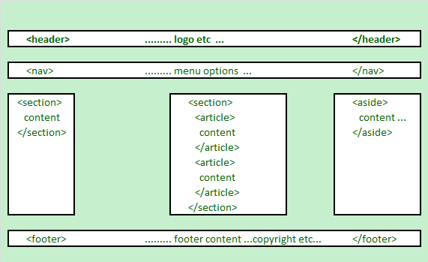
HTML5 Structural Elements
HTML 5 defines a number of new container elements for constructing documents.
header
nav,
section
aside
article
footer

Slide 19
HTML5 Structural Elements
Regarding <div> - The <div> element is the generic container for flow content, which does not inherently represent anything. It should be used only when no other semantic element (such as above elements) is appropriate.
Elements | Description
<header> | the web page/site header content
<nav> | the navigation functionality for the page/site.
<section> | the grouping of related subjects on the web page.
<main> | the main content on the web page.
<article> | contains a standalone content on the web page.
<aside> | used for content that's not central to the web page.
<footer> | the web page/site footer content

Slide 20
HTML5 Structural Elements
<body>
<header>......... logo etc ... </header>
<nav>......... menu options ... </nav>
<section id="sidebar1">......... section 1 ... </section>
<section id="main"><!-- may be replaced by main element -->
<article>article within the section </article>
<article>another article within the section </article>
</section>
<aside>......... aside content ... </aside>
<footer> ......... footer content ...copyright etc ... </footer>
</body>

Slide 21
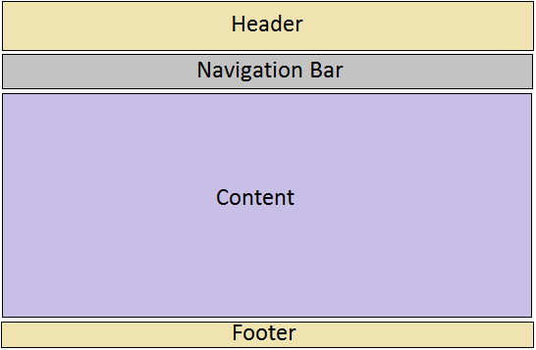
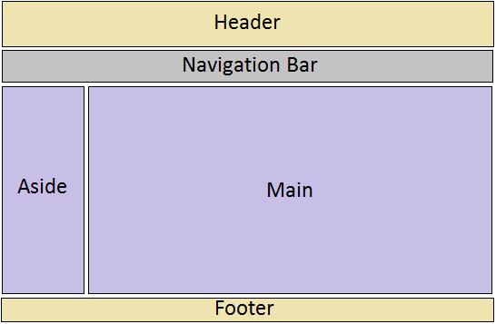
Web Page Layouts
One-column Layout
(See layout-1-column.html example)
Two-Column Layout
(See layout-2-column.html example)

Slide 22
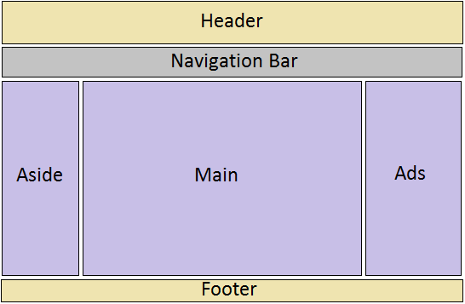
Web Page Layouts
Three-column Layout
(See layout-3-column.html example)

Slide 23
Create Layouts with HTML5 and CSS3
Creating 2-column fluid (float-based) layouts with CSS
Set the width of the page (e.g. 960px) and center the page:
Set the width of the “aside” block and float it to left:
Set the width of the “main” section and float it to left:
.container { width: 960px; margin: auto; }
aside { width: 192px; float: left; }
section.main { width: 768px; float: left; }

Slide 24
Create Layouts with HTML5 and CSS3
Set the clear property of the footer to ‘both’:
Set margin, border, padding, background-color, … to each structural element, e.g.:
Note: You can also use relative widths for the page and columns (ie, completed Lab 3)
footer { clear: both; background-color: #444; }
aside, section.main {margin-top: 58px; margin-right: 10px; margin-left: 10px; }

Slide 25
Navigation and Menus
Web page navigation
convert the unordered the list a navigation bar or menu.
<nav>
<ul>
<li><a href="#top">Home</a></li>
<li><a href="#timetable">Timetable</a></li>
<li><a href="#standards">Standards</a></li>
<li><a href="ibc233/ibc233.html">IBC233</a></li>
<li><a href="int222/int222.html">INT222</a></li>
<li><a href="bti220/bti220.html">BTI220</a></li>
</ul>
</nav>

Slide 26
Navigation and Menus
Single Level Menu Options
Horizontal Single Level Menu - (See menu-single-level-horizontal.html example)
Vertical Single Level Menu Example – (See menu-single-level-vertical.html example)
Multi Level Menu Options
Horizontal Multi Level Menu Example – (See menu-multi-level-horizontal.html example)
Vertical Multi Level Menu Example – (See menu-multi-level-vertical.html example)

Slide 27
Questions?
Any questions?
Would you like to see any more examples?

